Slide 1
How To Read Annual Reports / Financial Statements
Gustaf Haglund

Slide 2
Selective Reading
Skip what doesn’t really matter (of course, exceptions exist, just generally speaking here…)

Slide 4
Accounting Standards
IFRS/GAAP

Slide 5
Narratives
Never trust the story by face value alone

Slide 6
Key Pitfalls
Goodwill, intangibles, adjusted earnings, conditional payments, covenants…

Slide 7
Case Study: Wirecard
The importance of a coherent compliance story and how to spot narrative dissonance

Slide 8
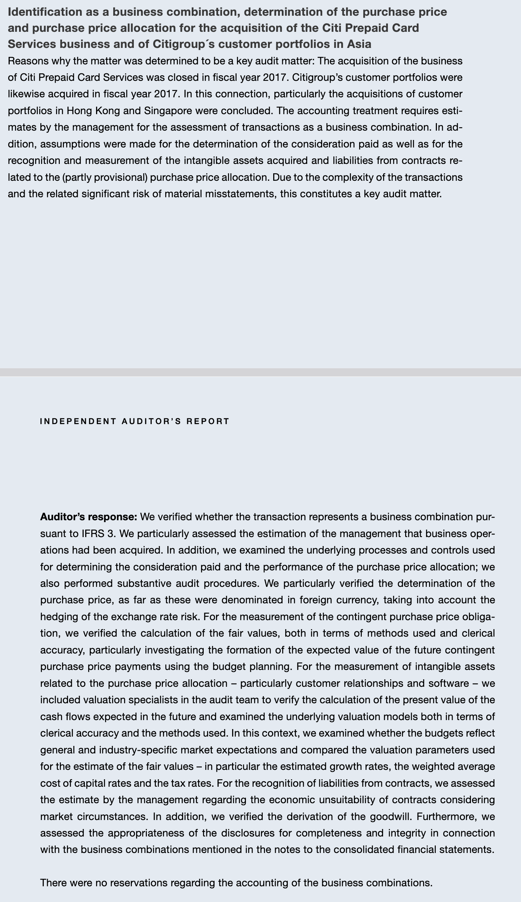
Straight from the Report
Some examples of smell in the Wirecard report (2017)
* The auditor noted material complexity in Asian M&A, and various subjective valuations, yet no reservations
* No segmented cash flow reporting, and no explanation of
3rd party dependencies or the risks involved in Asia… Even though there was substantial growth in Asia
* Likewise, no explanation how Wirecard’s liquidity structure really worked (counterparties, variance, etc.)
or the relevant liquidity risks involved. Lacking sensitivity analyses as well
Audit opinion: s.289, s.114–115 (liquidity analysis), s.271 (liquidity risk)

Slide 9
Know What The Auditor Does
What they do, and what they don’t

Slide 10
Yet Another Example,
What Auditors Don’t Do:
Intellego

Slide 11
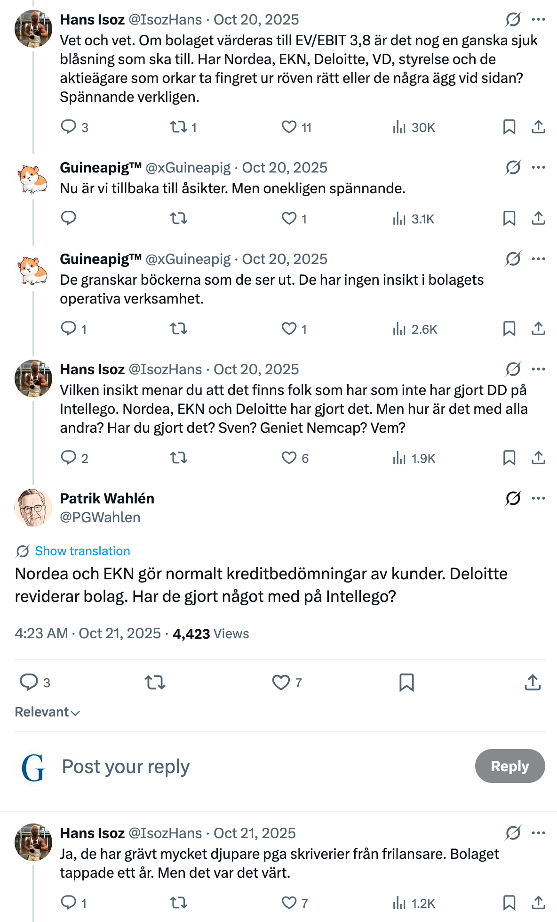
Intellego’s Auditors
“Grävt mycket djupare än skriverier från frilansare“
No.

Slide 12
Reverse Engineer the Statements
What assumptions need to be true for the story to hold?

Slide 13
Valuation Models & Circle of Competence
Of course you need to know how to value the company. Also, what you know – and don’t know.

Slide 14
The End
"Spend each day trying to be a little wiser than you were when you woke up.
Day by day, and at the end of the day—if you live long enough—most people get out of life what they deserve.“
– Charlie Munger

