Slide 1
Incentives and Corporate Governance
Gustaf Haglund, 2026-03-05

Slide 2
The Law of Incentive Gravity
Incentives = force field
Feedback loops = dynamics
Culture = friction
Local & global optima (sometimes differing incentives inside the org.)
Minimization of action (conserving energy)
Governance failures = expected failures in faulty systems
“Show me the incentive and I will show you the outcome“ – Charlie Munger

Slide 3
Why Governance Failures Are Predictable
Principal-Agent Problem (skin in the game)
Asymmetric information
Delayed feedback (meta-stability)
Culture as constraint

Slide 4
Principal-Agent Problem
Internal payoff function (incentive program)
Boards lack real-time feedback
Incentives encourage behaviors long before numbers reveal them

Slide 5
Delayed Feedback
Problems tend to appear first when they are hard to correct
Meta-stability: stable, stable, stable, unstable… (e.g. loan collateral)
Positive feedback: Incentives driving short-term optimization -> Short-term optimization -> Numbers look better -> Repeat
Negative feedback not working: Whistleblowers thrown out, control functions lacking power, the board dependent on executives

Slide 6
Culture
The internally permissible framing of issues have outsized impact on readiness
Control functions are only effective when culturally allowed to

Slide 7
Deformed Incentives
EBITDA-linked compensation (resulting in optimizing for… adjusting EBIT)
Shifting costs to intangibles
If growth = value, then growth is being optimized, resulting in higher burn rate
Adjusted IFRS & Non-GAAP adjustments
Shifting KPIs = signal loss
Boards not independent of executives

Slide 8
Exit Incentives: VC/LBO
IRR optimization (dividends, buybacks, short-term cost cuts)
“Window dressing“ when raising capital

Slide 9
Loyalty Over Competence
“Dictators & Their Viziers“ (Egorov/Sonin)
When leadership is afraid, loyalists get promoted to the detriment of competence
Symptoms: CFOs regularly kicked out, auditors marginalized, whistleblowers fired

Slide 10
Why Internal Controls Often Are Theatre
COSO on paper vs. COSO in reality
Incentives, incentives, incentives (who do you report to?)

Slide 11
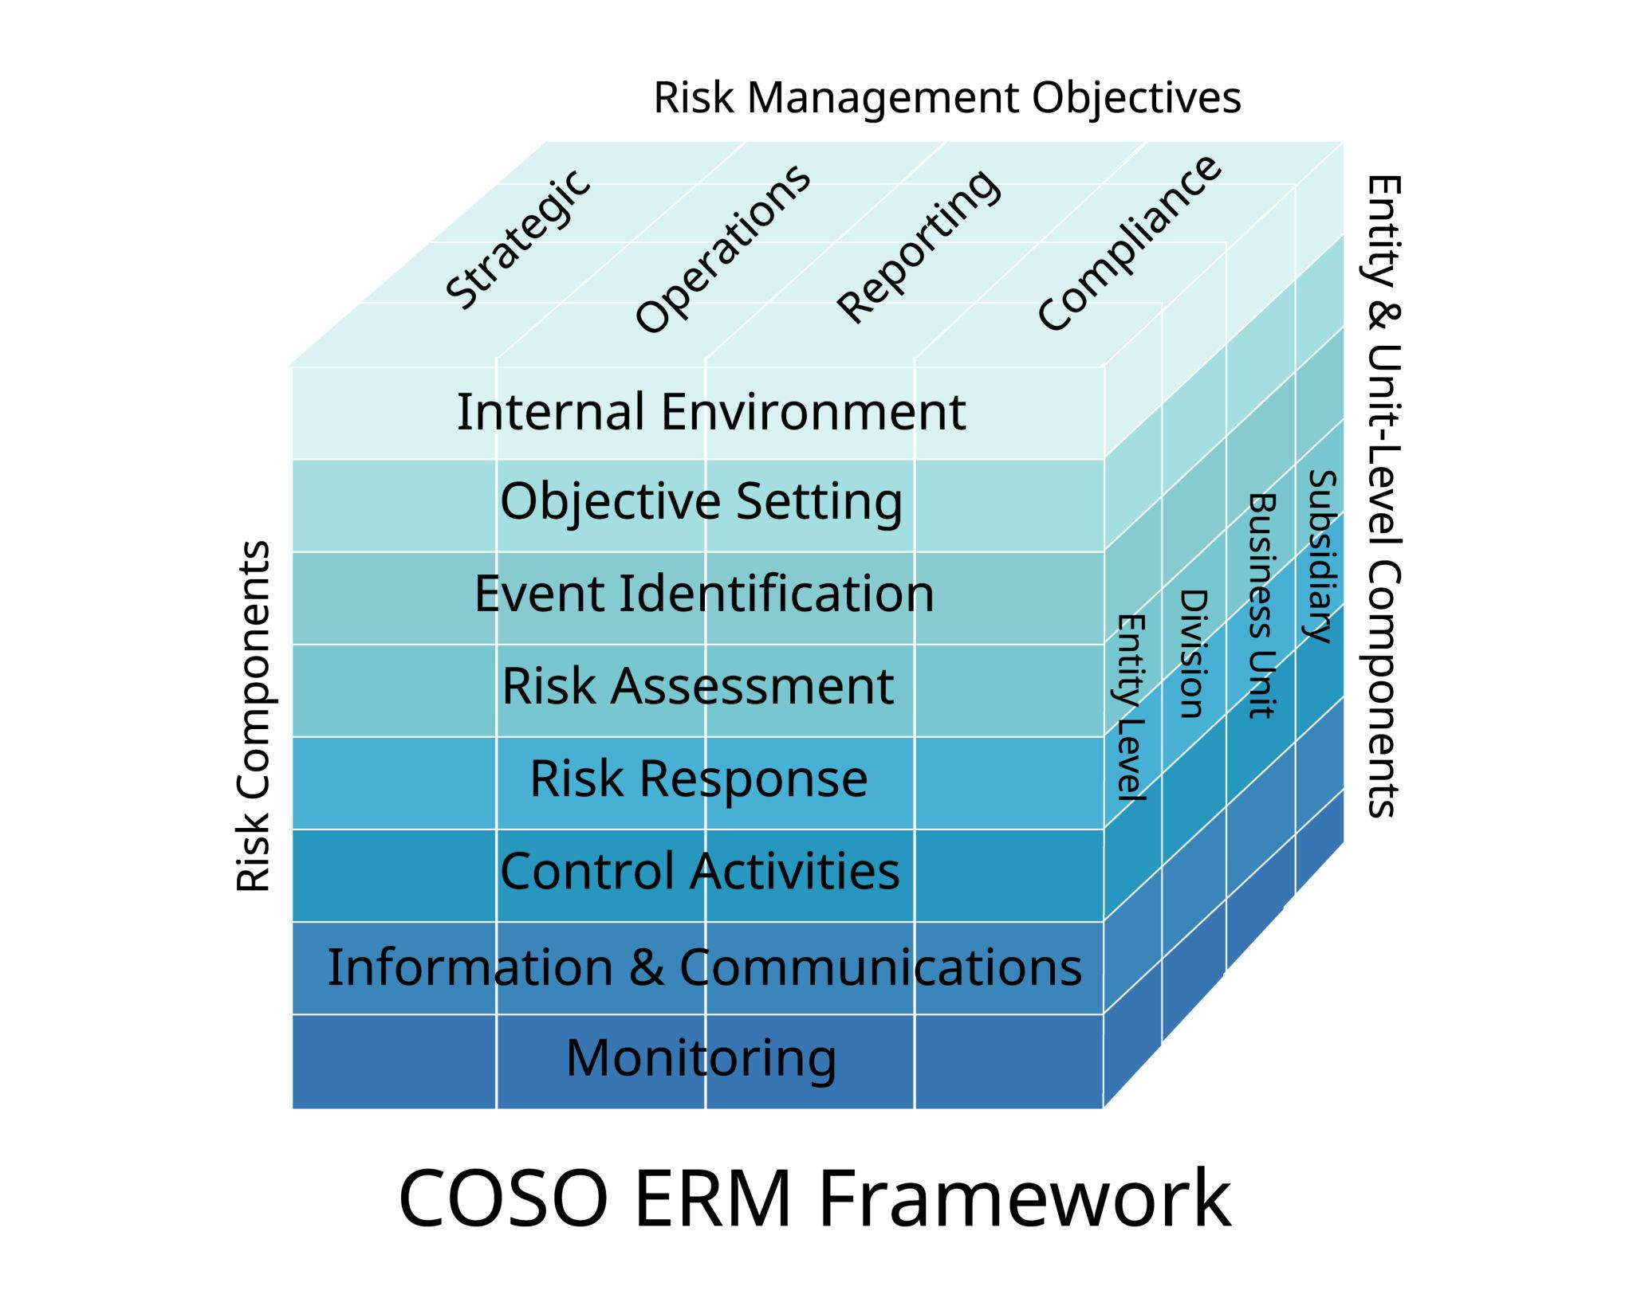

Slide 12
Storytelling
The narrative design reveals what the company prioritizes
Growth -> Reward -> Feedback strengthening that narrative
Critics are seen as obstacles, not sensors

Slide 13
Case: Enron
Incentive: Short-term profit reporting
Feedback: The market rewarded creative accounting (mark-to-market + options)
Result: Meta-stability -> Collapse, systemic blindness

Slide 14
Case: Wirecard
Incentive: Acquisitions & Storytelling
Feedback: Regulators & banks bought into the illusion
Culture: “If you question us, you’re the problem“

Slide 15
Case: Viaplay
Incentive: Promote subscriptions growth, not cash flow
Feedback: Delayed in numbers, absolute in outcome
Result: Collapse in numbers before the board understood the forces at play

Slide 16
Case: Yubico
Incentive: IPO expectations
Storytelling: Fancy tech, successful adoption of core tech
Signs of troubles: CEO sold his shares & expensive to borrow shares (impeding shorting)

Slide 17
Why Investors Still Buy
Social proof
Authority bias
Narrative fallacy
Incentive-caused bias
Overconfidence, being outside the Circle of Competence, & information noise
People choose narrative > signals because the narrative is easier to believe in

Slide 18
How To Spot Faulty Systems
Quick KPI shifts
Compensation tied to adjustable metrics / short-term incentives
Oddly often new CFOs, top talent leaving despite success (at the surface level)
Control functions with unclear mandate
Criticism is taken as indicating a negative personality
Storytelling increasing over time
Forward-looking statements en masse, with weak connection to cash flows
Analysts seem to pretty much think the same, refer to company narratives (notice their own incentives…)
Core question: “What behavior is rational considering the incentives?“

Slide 19
The End: Governance Failures Are Not Exceptional
Companies don’t fail despite the incentives, they fail due to them
Governance failures are the model if the incentives are wrong
Ask what isn’t being mentioned despite the relevancy
Human nature at play

